Slide 1
NETFLIX DATA ANALYSIS USING SQL
Present by :- Kajal Kewat

Slide 2

OBJECTIVE
Analyze content trends by year, type, and duration to understand platform growth.
Examine geographic distribution of shows to evaluate global content spread.
Identify top genres, directors, and cast members driving platform engagement.
Assess content rating patterns to understand target audience demographics.
Discover recent additions, high-duration titles, and regional content preferences.

Slide 3
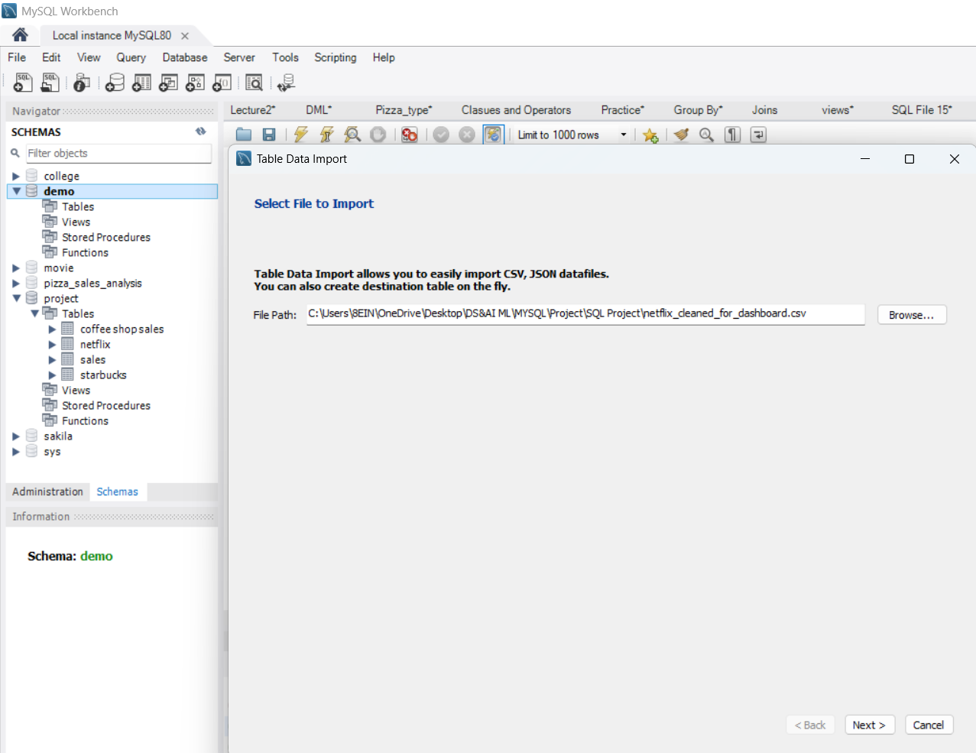
Importing DATASET IN SQL DATABASE
Step 1 :- Created a database and imported the dataset into the table

Slide 4
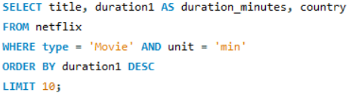
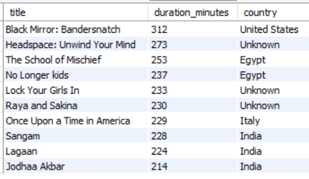
Top 10 Longest Movies
Query :-
Output :-

Slide 5
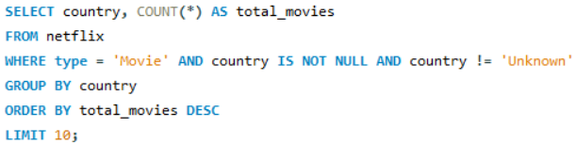
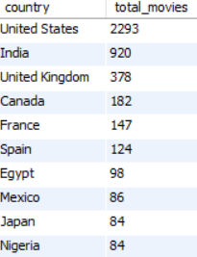
Top 10 Countries by Number of Movies
Query :-
Output :-

Slide 6
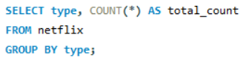
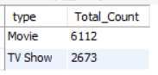
Total Movies and Shows
Query :-
Output :-

Slide 7
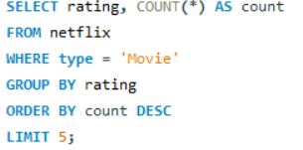
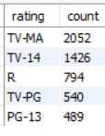
Most Common Movie Ratings
Query :-
Output :-

Slide 8
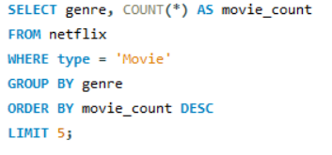
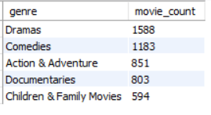
Top 5 Genres for Movies
Query :-
Output :-

Slide 9
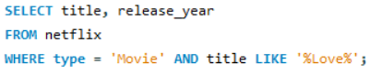
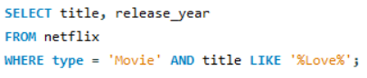
Find Movies with "Love" in the Title
Query :-
Output :-

Slide 10
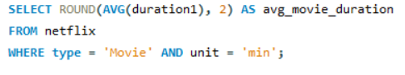
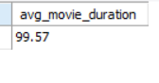
Average Duration of Movies
Query :-
Output :-

Slide 11
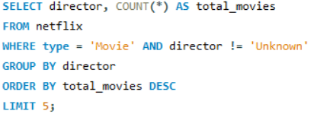
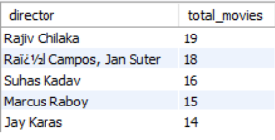
Top Directors by Movie Count
Query :-
Output :-

Slide 12
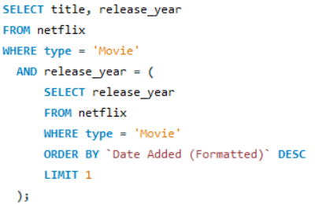
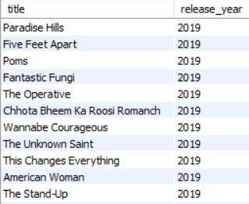
movie titles released in the same year
Query :-
Output :-

Slide 13
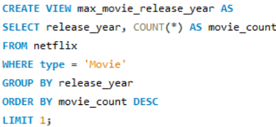
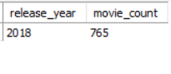
VIEW FOR MAXIMUM MOVIES BY YEAR
Query :-
Output :-

Slide 14
INSIGHTS GAINED
Content additions have increased steadily over the years, showing platform growth.
The United States and India lead in content production, indicating major content hubs.
TV Shows and Movies vary significantly in duration, reflecting different content formats
Popular genres and frequent directors reveal audience preferences and content trends
New content is being added regularly, with a spike in the last six months.
Several shows exceed average duration, highlighting binge-worthy or premium titles.
Titles often contain common keywords like 'Love', pointing to popular content themes.

Slide 15
Conclusion
Identify the most active years and countries for movie production.
Analyze content trends based on genre, duration, and audience rating.
Detect missing or incomplete metadata (like unknown cast or directors)
Extract recently added movies and popular genres by region
Explore user-oriented content patterns such as keywords in titles.

Slide 16
Thank you

